Slide 1
Dropout
Instructor: Dr. Yan Yan

Slide 2

Recipe of Deep Learning
YES
Early Stopping
Good Results on Testing Data?
Regularization
Dropout
YES
New Activation Function
Good Results on Training Data?
Adaptive
Learning Rate

Slide 3
Dropout
Training:
Each time before updating the parameters
Each neuron has p% to dropout

Slide 4
Dropout
Training:
Thinner!
Each time before updating the parameters
Each neuron has p% to dropout
The structure of the network is changed.
Using the new network for training
For each mini-batch, we resample the dropout neurons

Slide 5
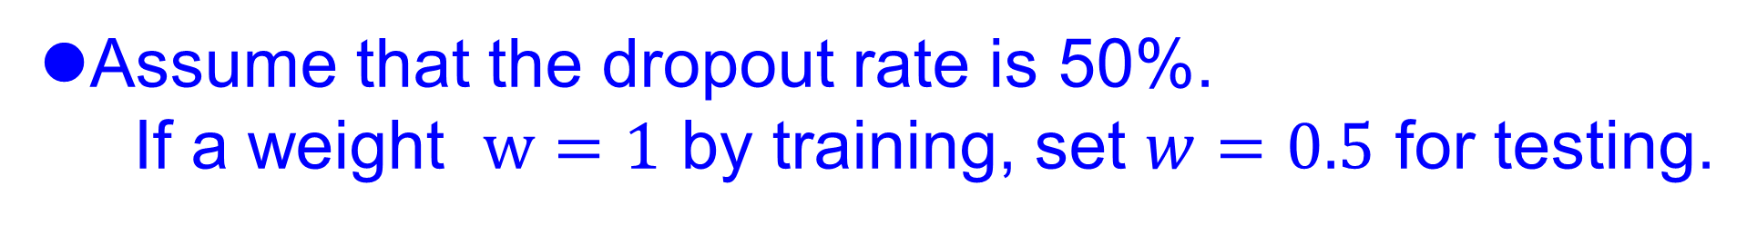
Dropout
Testing:
No dropout
If the dropout rate at training is p%, all the weights times 1-p%
Assume that the dropout rate is 50%.
If a weight $w=1$ by training, set $w=0.5$ for testing.

Slide 6
Dropout - Intuitive Reason
My teammate will not work hard on project. I need to work hard.
When teams up, if everyone expect the partner will do the work, nothing will be done finally.
However, if you know your partner will dropout, you will do better.
When testing, no one dropout actually, so obtaining good results eventually.

Slide 7
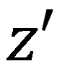
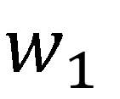

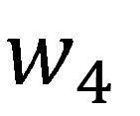
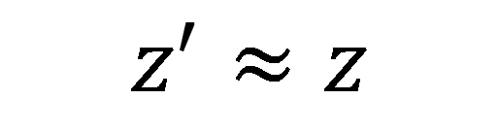
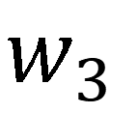
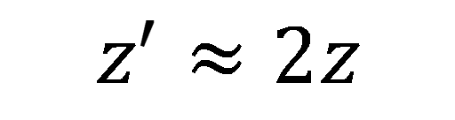
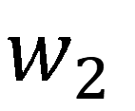
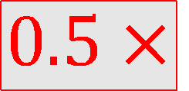
Dropout - Intuitive Reason
Why the weights should multiply (1-p)% (dropout rate) when testing?
Training of Dropout
Testing of Dropout
Assume dropout rate is 50%
No dropout
Weights from training
$$w_{1}$$
$$0.5×$$
$$w_{1}$$
$$z^{′}≈2z$$
$$w_{2}$$
$$z$$
$$0.5×$$
$$w_{2}$$
$$z^{′}$$
$$w_{3}$$
$$0.5×$$
$$w_{3}$$
$$w_{4}$$
$$0.5×$$
$$w_{4}$$
Weights multiply 1-p%
$$z^{′}≈z$$

Slide 8
Dropout is a kind of ensemble.
Training Set
Ensemble
Set 1
Set 2
Set 3
Set 4
Network
1
Network
2
Network
3
Network
4
Train a bunch of networks with different structures

Slide 9
Dropout is a kind of ensemble.
Ensemble
Testing data x
Network
1
Network
2
Network
3
Network
4
y₁
y₂
y₃
y₄
average

Slide 10
Dropout is a kind of ensemble.
minibatch
1
minibatch
2
minibatch
3
minibatch
4
Training of Dropout
M neurons
……
2^{M} possible networks
Using one mini-batch to train one network
Some parameters in the network are shared

Slide 11
Dropout is a kind of ensemble.
Testing of Dropout
testing data x
All the weights multiply 1-p%
……
y₁
y₂
y₃
?????
average
≈
y

Slide 12

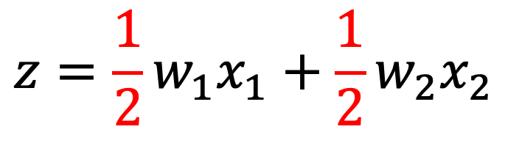
Testing of Dropout
x₁
x₂
x₁
x₂
x₁
x₂
w₁
w₂
w₁
w₂
w₁
w₂
z=w₁x₁+w₂x₂
z=w₁x₁+w₂x₂
z=w₂x₂
x₁
x₂
x₁
x₂
x₁
x₂
$$\frac{1}{2}$$
$$\frac{1}{2}$$
w₁
w₁
w₁
w₂
w₂
w₂
$$z=\frac{1}{2}w_{1}x_{1}+\frac{1}{2}w_{2}x_{2}$$
z=w₁x₁
z=0

Slide 13
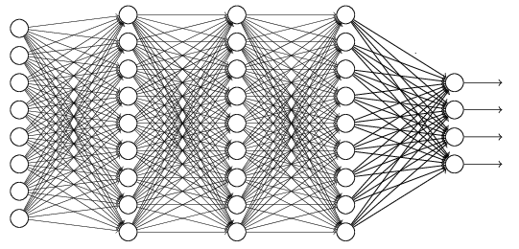
Recipe of Deep Learning
YES
Step 1: define a set of function
Step 2: goodness of function
Step 3: pick the best function
NO
Good Results on Testing Data?
Overfitting!
YES
NO
Good Results on Training Data?
Neural Network

